Slide 1

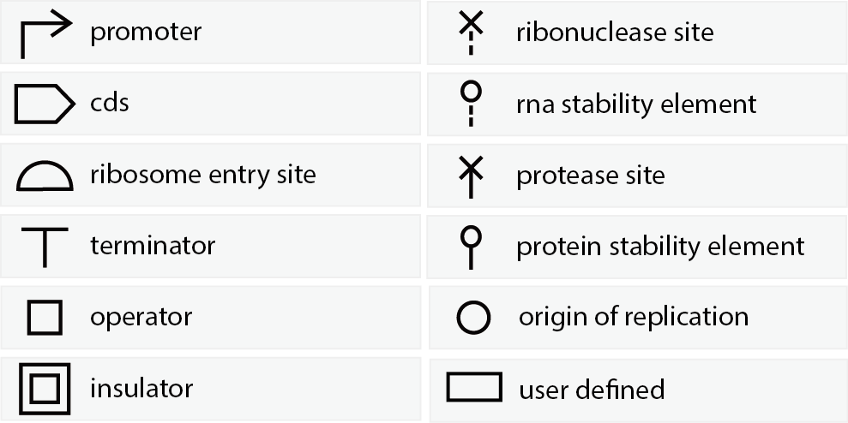
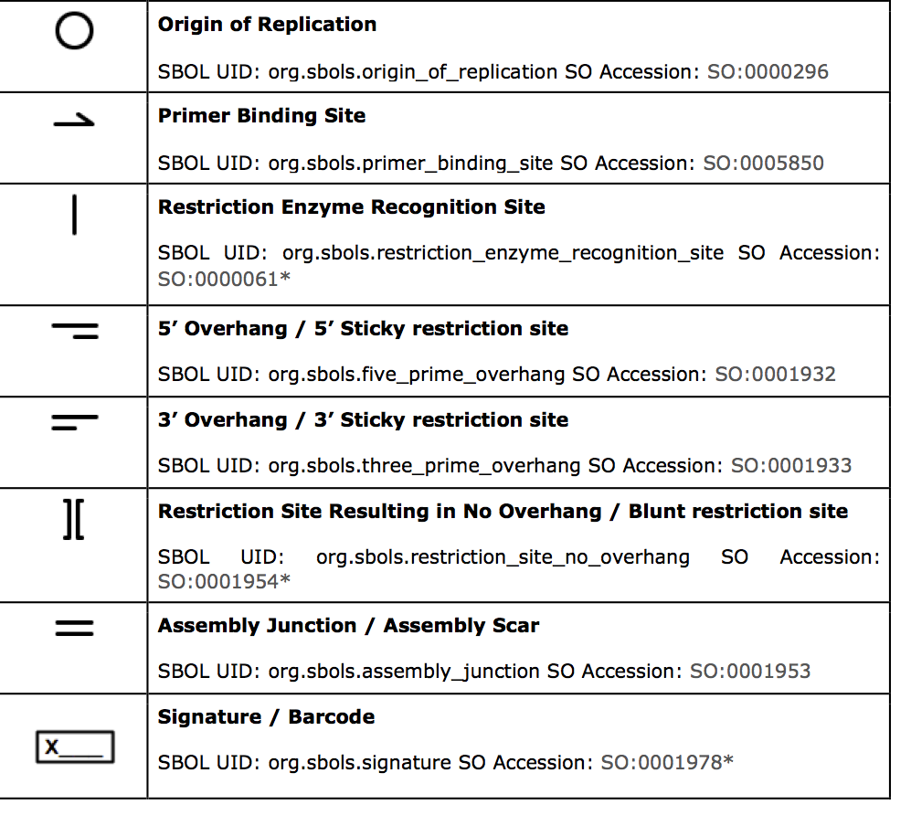
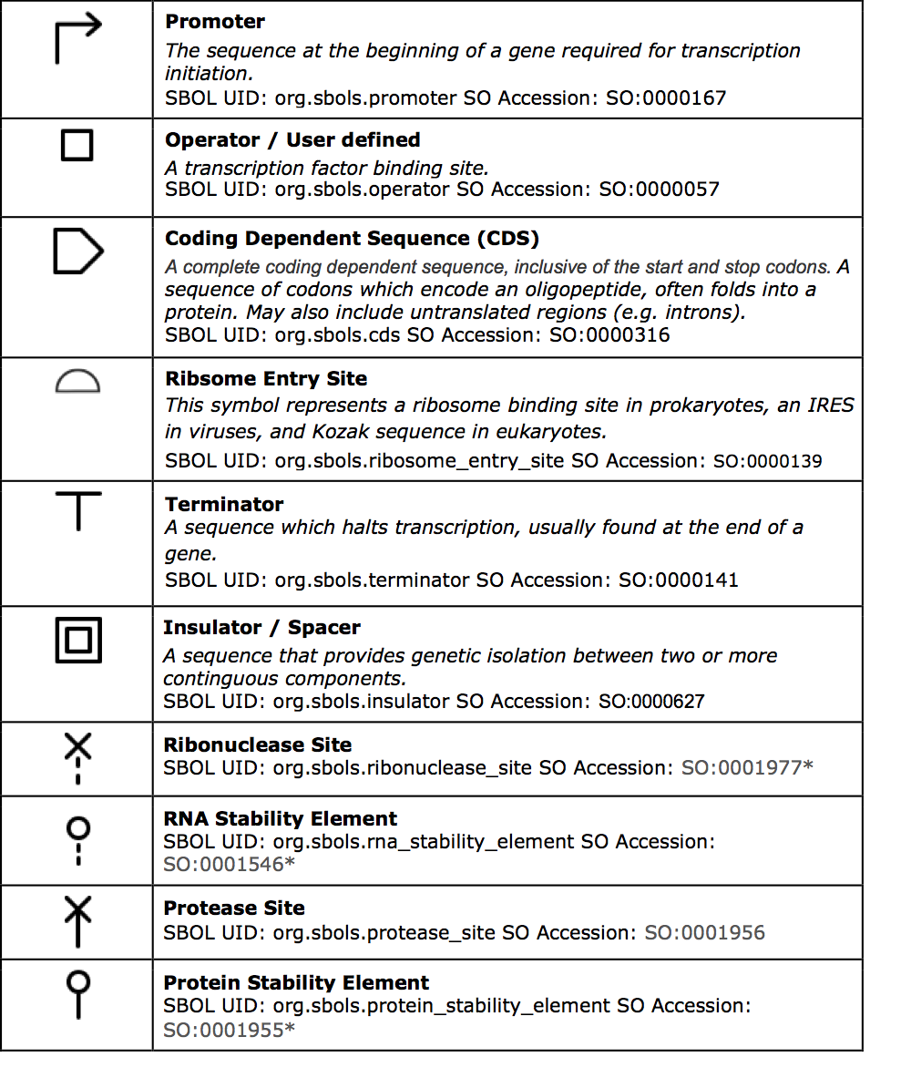
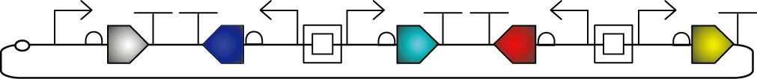
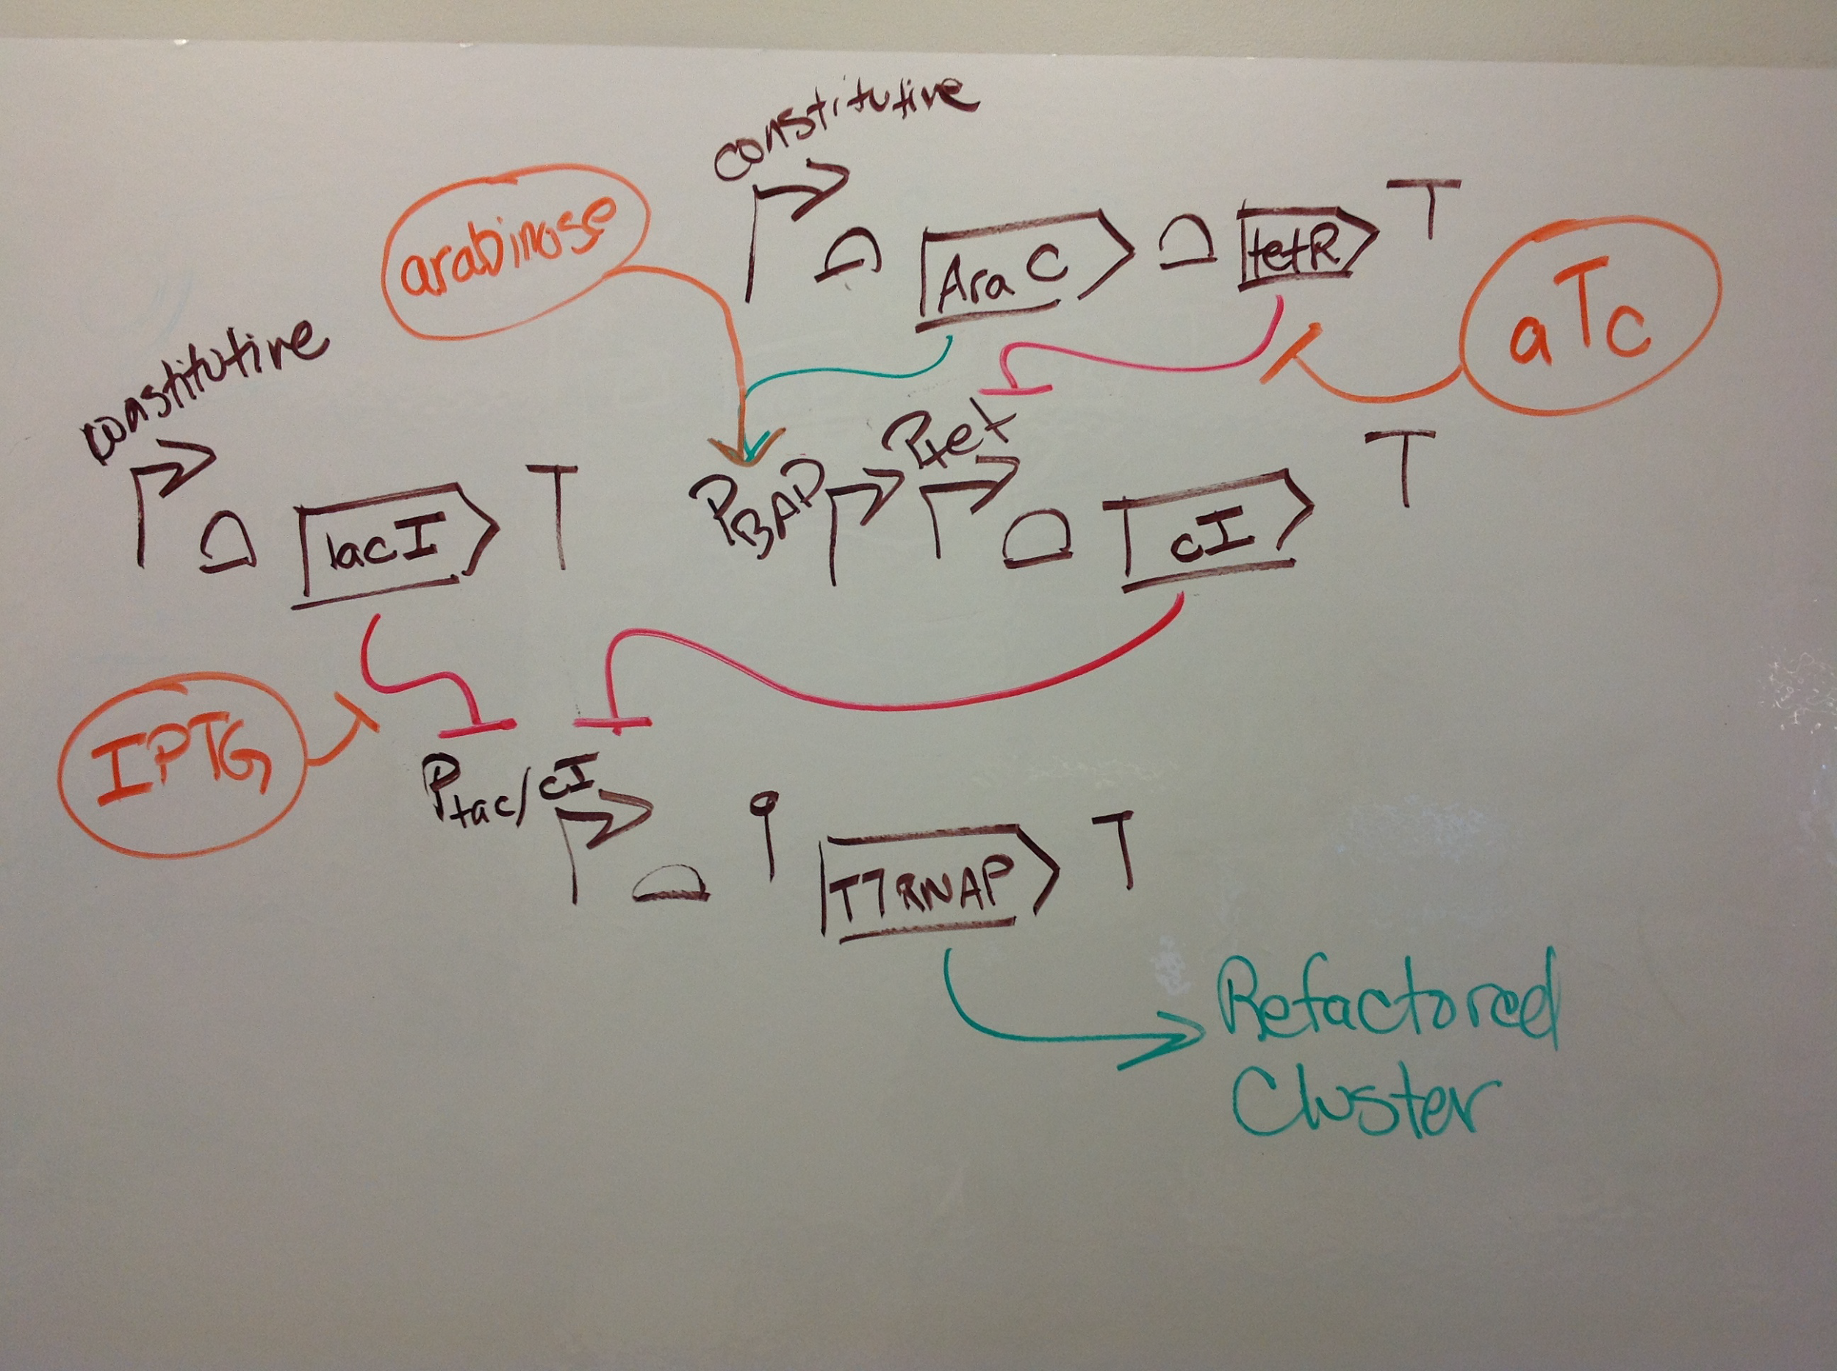
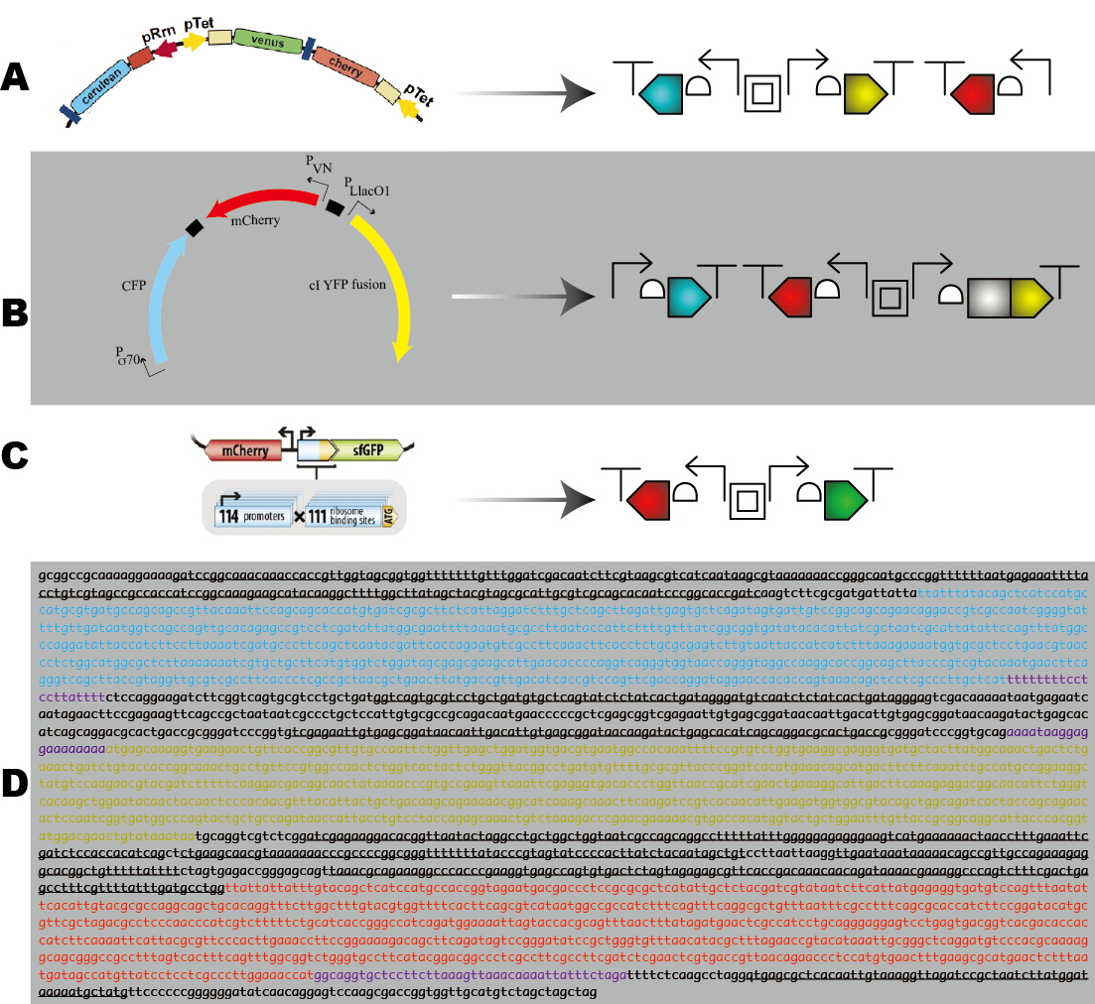
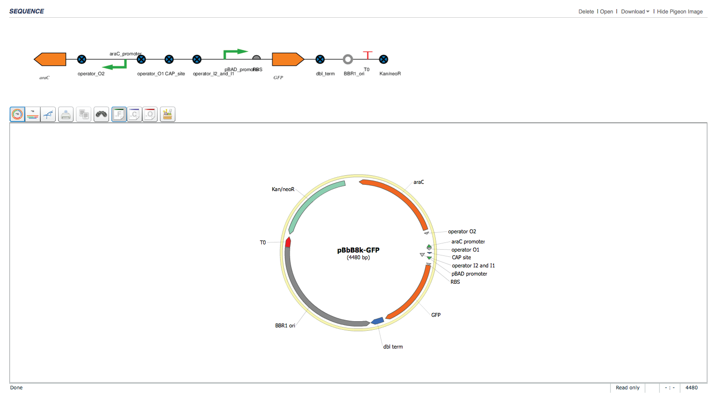
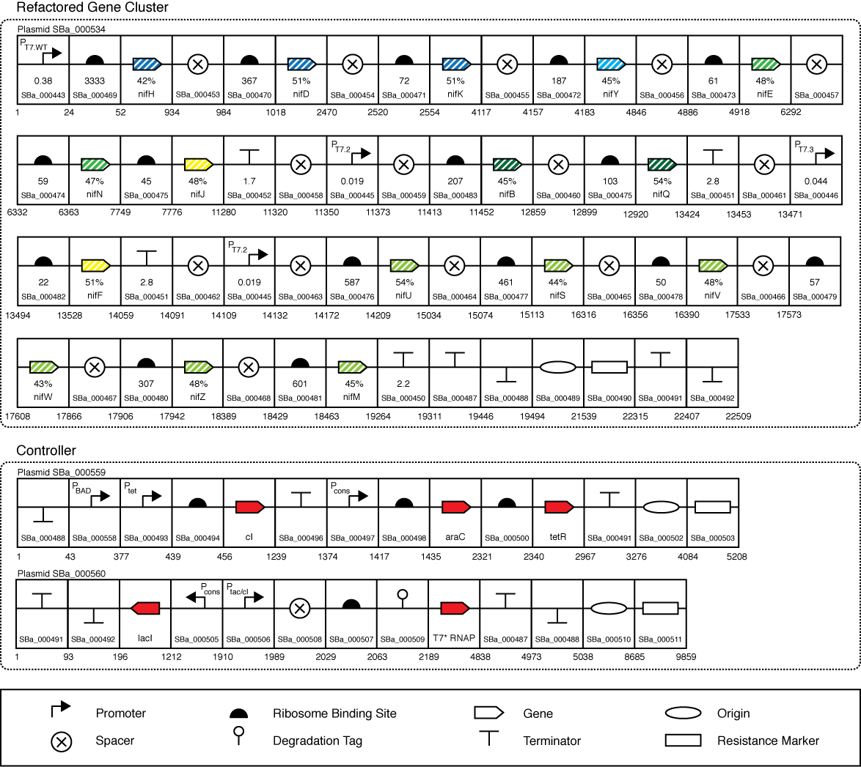
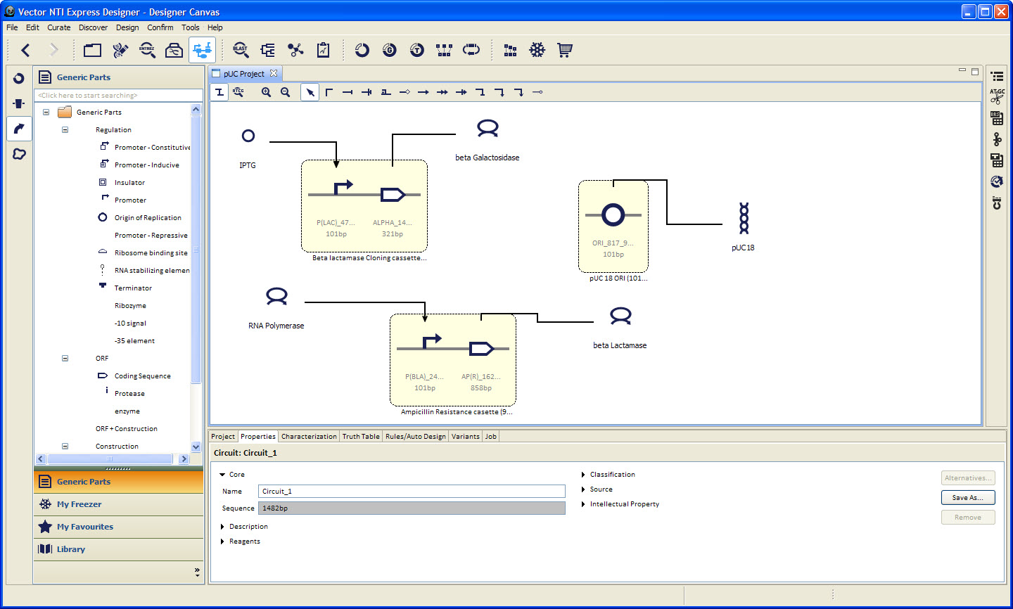
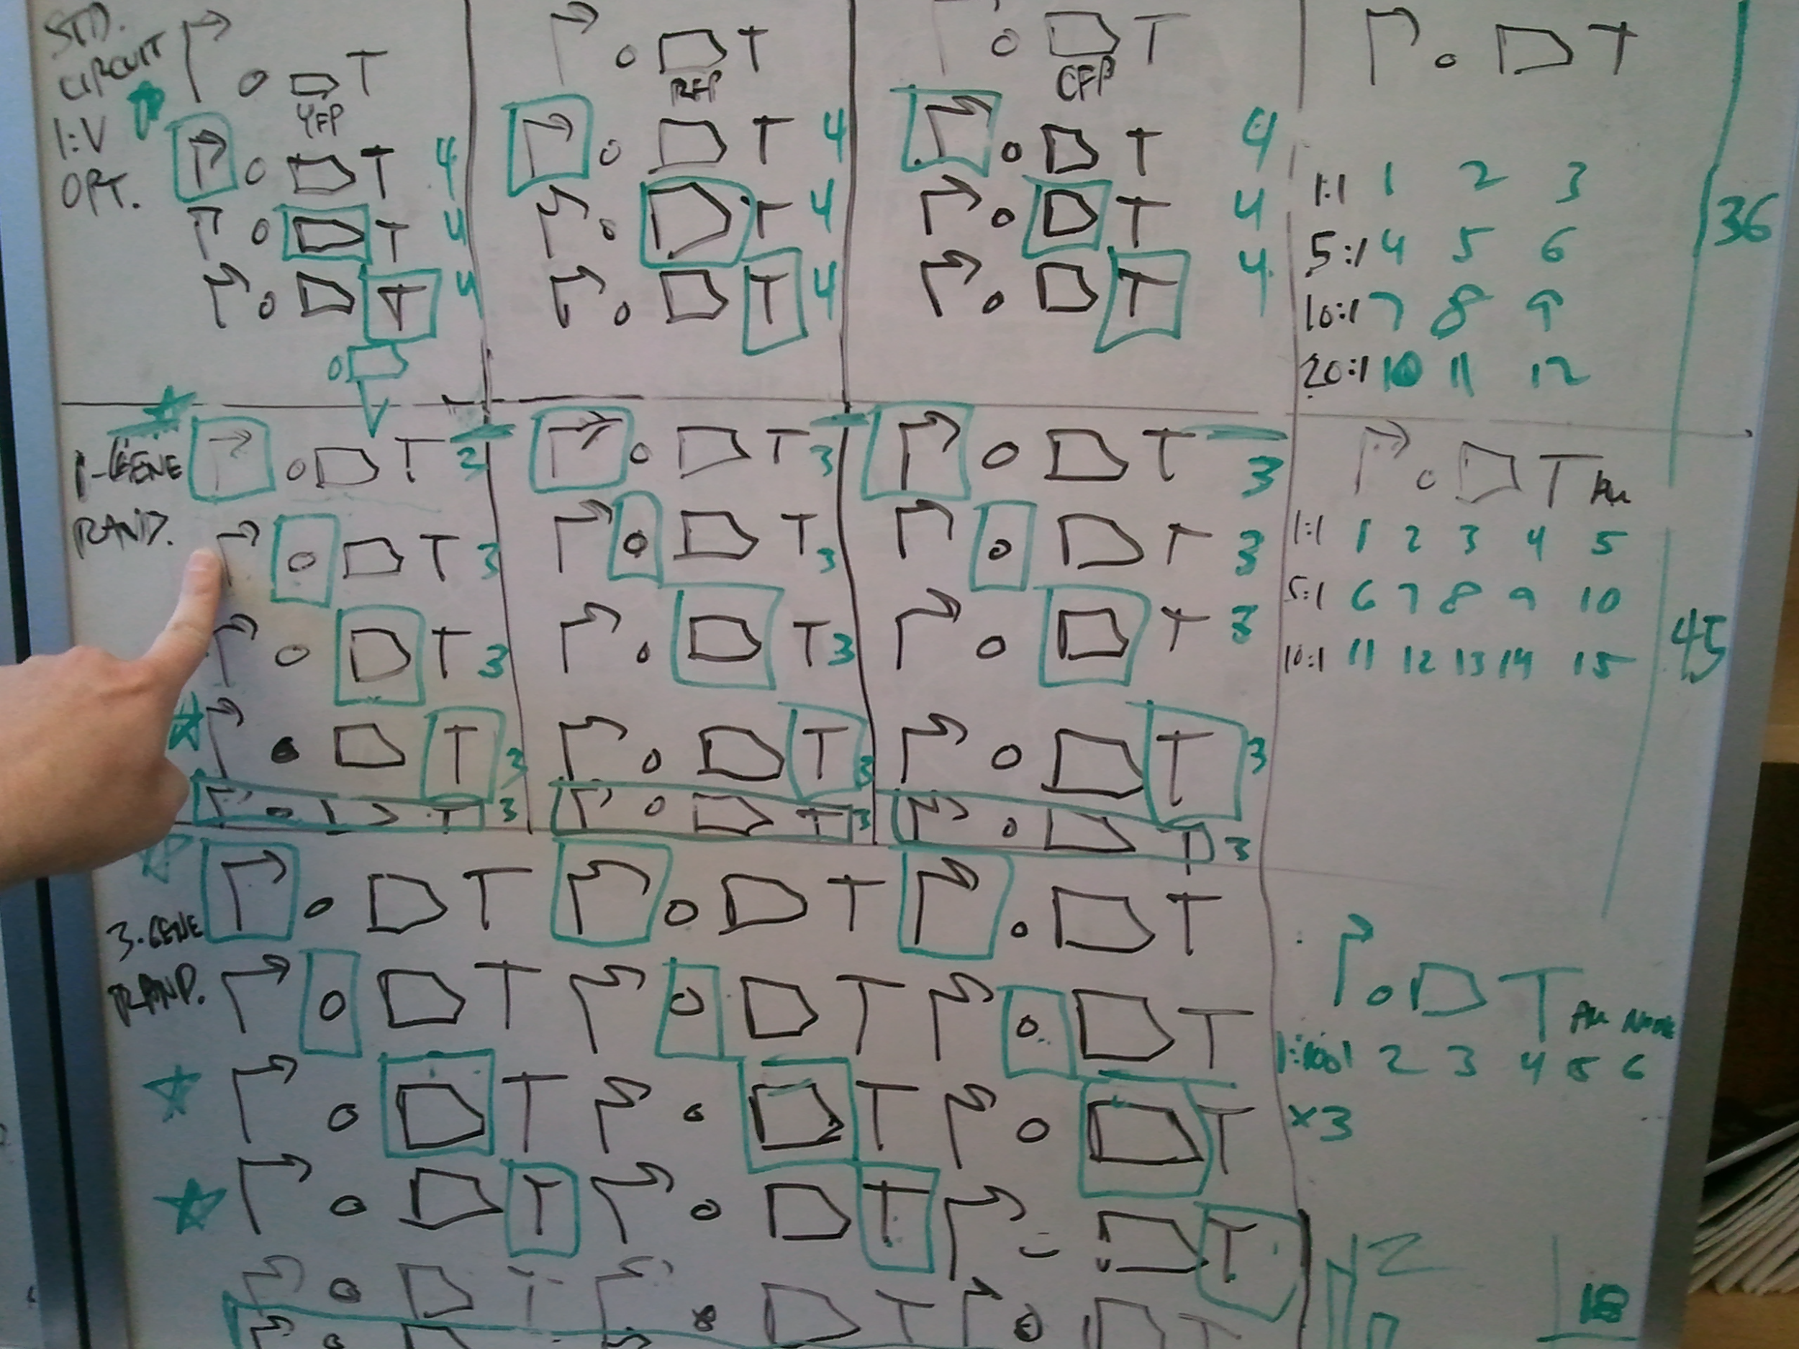
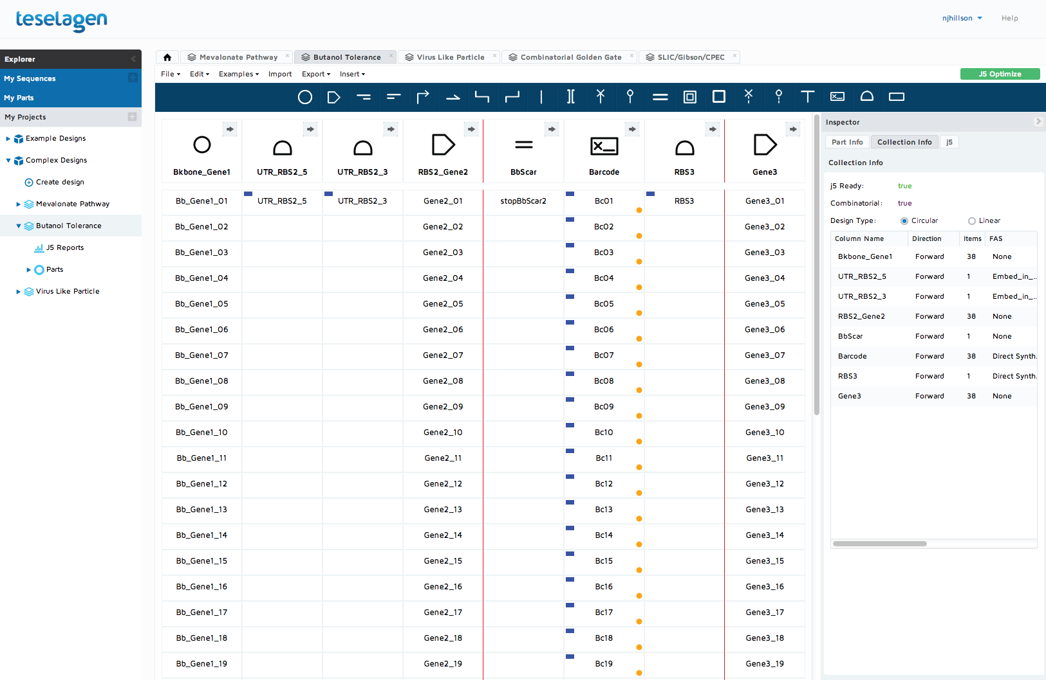
SBOL Visual aids rapid communication of variant synthetic DNA designs.
Jacqueline Quinn, Robert Sidney Cox III, Aaron Adler, Jacob Beal, Swapnil Bhatia, Yizhi Cai, Joanna Chen, Kevin Clancy, Michal Galdzicki, Nathan J. Hillson, Nicolas Le Novere,
Akshay Maheshwari, James Alastair McLaughlin, Chris Myers, Umesh P, Matthew Pocock, Cesar Rodriguez, Larisa Soldatova, Guy-Bart Stan, Neil Swanston, Anil Wipat, Herbert M. Sauro
Abstract
The SBOLv Glyphs and their Meanings
Synthetic Biology Open Language (SBOL) Visual is an effort to standardize visual representations of synthetic biological constructs, and is a human-readable counterpart to the SBOL standard data format for representing construct design. SBOL Visual 1.0 consists of a set of standardized glyphs for representing designs of synthetic genetic systems as contiguous constructs. Each symbol corresponds to a sequence element in physical DNA, including simple regulatory elements such as promoters and DNA construction features like restriction sites. The symbols can be used as stencils to make illustrations on at the computer or by hand, for rendering in a web browser, as images for software design, or as a formal set of symbols for communication and instruction. SBOL Visual symbols are currently used by a number of commercial and academic software tools. SBOL Visual is particularly well suited to represent the design of multi-component artificial genetic constructs, and we present examples where SBOL Visual has been employed for scientific descriptions of such constructs. SBOL Visual is developed by members of SBOL Developers Group to ensure cross-compatibility with other biological standards. SBOL Visual is a free and open standard with resources made available for the broadest possible use under the Creative Commons CC0 “public domain” license. The symbols are provided for personal, academic, and commercial use in a variety of image formats, including PNG and SVG. We encourage any interested practitioners to download the images, use and modify them freely, suggest changes, and join the SBOL Visual community to participate in developing the standard:
http://www.sbolstandard.org/visual
Current SBOL Visual Core Glyphs
Glyphs for DNA Construction
Sequence Ontology
Example: Four color genetic reporter on plasmid
SBOL Visual in Use
Acknowledgements
Whiteboard Discussions
Scientific Publications
Software/CAD Tools
The authors thank all members of the SBOL effort, past and present, for their support of and contributions to SBOL Visual, and the members of the Computational Modeling in Biology Network (http://co.mbine.org/) for welcoming SBOL into the consortium and for their continued collaborative efforts.
The authors thank Reshma Shetty for publishing the first SBOL Visual Omnigraffle stencil. The authors would like to particularly thank Suzie Bartram, Anusuya Ramasubramanian, and Drew Endy for publishing the first SBOL Visual RFC and inspiring the formation of the SBOL Visual project.
The authors acknowledge funding from Autodesk, Inc., Stanford University, Brunel University, and the National Science Foundation Synthetic Biology Engineering Research Center and Grant EF-0850100. The portion of this work conducted by the Joint BioEnergy Institute was supported by the Office of Science, Office of Biological and Environmental Research, of the U.S. Department of Energy (Contract No. DE-AC02-05CH11231). The portion of the work conducted by the University of Washington was supported by the National Library of Medicine (R41 LM010745), the National Human Genome Research Institute (R42 HG006737) and NSF awards: Theoretical Biology 0827592, Molecular and Cellular Biosciences 1158573. The portions of this work conducted by Newcastle University and Imperial College London were supported by the U.K. Engineering and Physical Sciences Research Council (Flowers Consortium, Grant No. EP/J02175X/1). The work conducted by the University of Manchester was supported by the U.K. Biotechnology and Biosciences Research Council (Centre for Synthetic Biology of Fine and Speciality Chemicals (SYNBIOCHEM); BB/M017702/1). The work conducted by the University of Edinburgh was supported by a Chancellor's Fellowship and BBSRC grant (Building national hardware and software infrastructure for UK DNA Foundries; BB/M025640/1). Finally, SBOL is supported by the National Science Foundation under Grant Nos. DBI-1356041, and DBI-1355909. Any opinions, findings, and conclusions or recommendations expressed in this material are those of the author(s) and do not necessarily reflect the views of the National Science Foundation.
Design of Genetic Circuits
Cox, III, Sidney R et al. A synthetic three-color scaffold for monitoring genetic regulation and noise. J Biol Eng. BioMed Central Ltd; 2010;4: 10. doi:10.1186/1754-1611-4-10
JBEI ICE Registry
http://www.pigeoncad.org
Dunlop MJ, Cox, III, Sidney R, Levine JH, Murray RM, et al. Regulatory activity revealed by dynamic correlations in gene expression noise. Nat Genet. Nature Publishing Group; 2008;40: 1493–1498. doi:10.1038/ng.281
Kosuri S et al., Composability of regulatory sequences controlling transcription and translation in Escherichia coli. doi:10.1073/pnas.1301301110
Life Technologies VectorNTI Express Designer
Combinatorial Designs
pConst
Gal4VP16
2A
rtTA3
Poly (A)
http://www.teselagen.com
pConst
cas9m-BFP
Poly (A)
CRa-U6
gRNA-b
CRP-b
EYFP
Poly (A)
pConst
mKate
Poly (A)
Kiani et al., CRISPR transcriptional repression devices and layered circuits in mammalian cells, Nature Methods, 11(7), July 2014
Temme et al. Refactoring the nitrogen fixation gene cluster from Klebsiella oxytoca. Proc Natl Acad Sci U S A. 2012;109: 7085–7090. doi:10.1073/pnas.1120788109

